Slide 1
C/C++ Program Design
CS205
Prof. Shiqi Yu (于仕琪)
yusq@sustech.edu.cn
http://faculty.sustech.edu.cn/yusq/

Slide 2


About me
Prof. Shiqi Yu (于仕琪)
Department of Computer Science and Engineering in Southern University of Science and Technology(南方科技大学计算机科学与工程系)
Office : Room 312, South Tower, CoE Building
Email : yusq@sustech.edu.cn
Homepage: http://faculty.sustech.edu.cn/yusq/

Slide 3

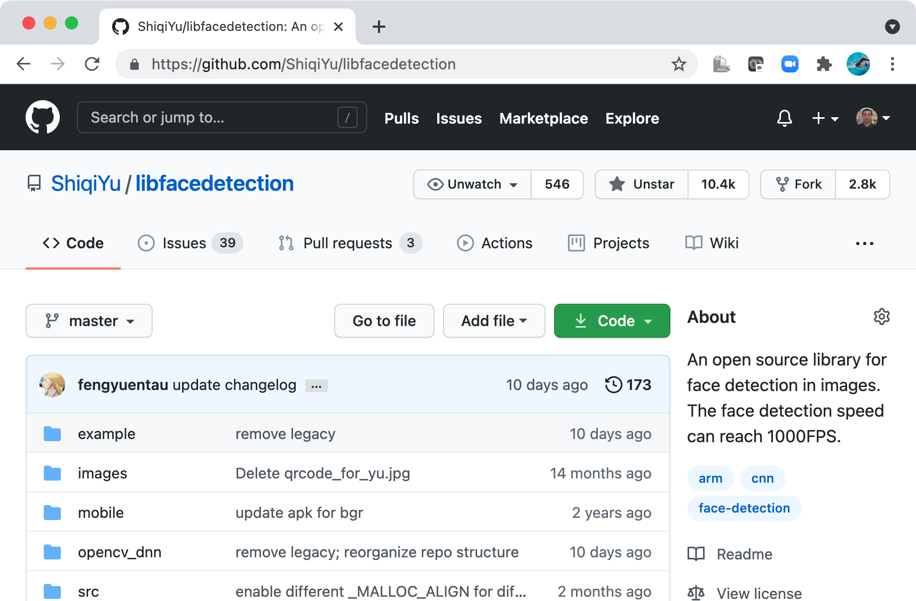
My Open Source Project

Slide 4
About the Course

Slide 5
Grade Component
Quiz: 5% (the best N-1 scores)
Lab Attendance and Exercise: 5% (the best N-1 scores)
Project: 65%
~5 projects, some are easy projects
Grading standard:
90-100: Finish all tasks almost perfectly
80-90: Finish all tasks well
70-80: Finish all tasks
Exam: 25%

Slide 6

Honesty
Get code from the internet for labs/assignments is perfectly OK
When you borrow, just say it.
You don't need to reinvent the wheel
DON’T pretend that you are the author of something that you didn‘t write. Otherwise, the score will be ZERO!

Slide 7
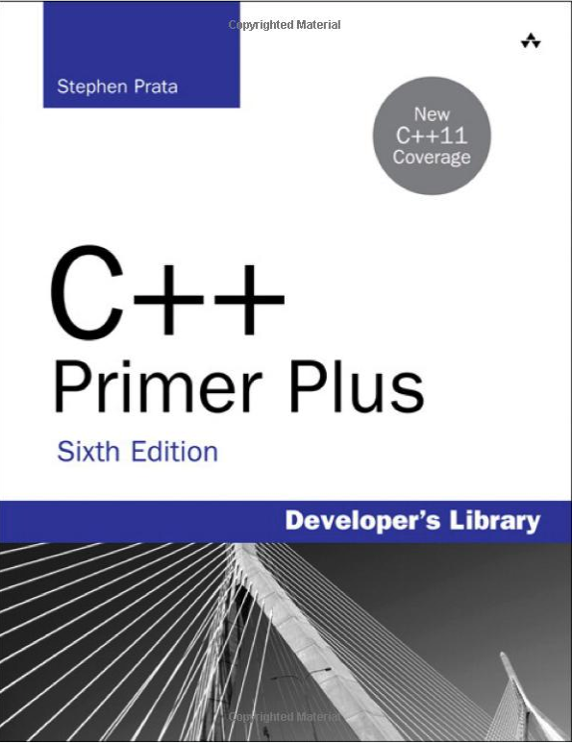
Resources
Blackboard:
C/C++ Program Design
Useful websites:
https://en.cppreference.com/w/
https://www.w3schools.com/cpp/
http://cpp.sh/
https://www.onlinegdb.com/

Slide 8
The First Example

Slide 9
hello.cpp
//C++ example in C++11
#include <iostream>
#include <vector>
#include <string>
using namespace std;
int main()
{
vector<string> msg {"Hello", "C++", "World", "!"};
for (const string& word : msg)
{
cout << word << " ";
}
cout << endl;
}

Slide 10
Compile and run the program
Compile hello.cpp
g++ hello.cpp
Initialization of msg is a C++11 extension. We need
g++ hello.cpp --std=c++11
Executable file can be generated as a.out. Change the output filename by -o option
g++ hello.cpp --std=c++11 -o hello
Execute
./hello

Slide 11
Different Programming Languages

Slide 12
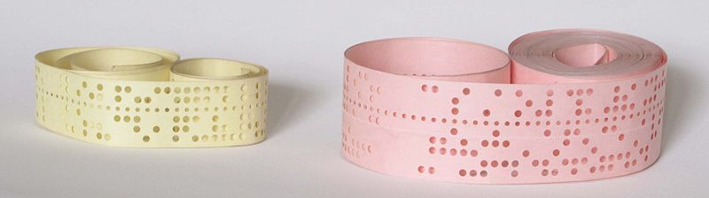
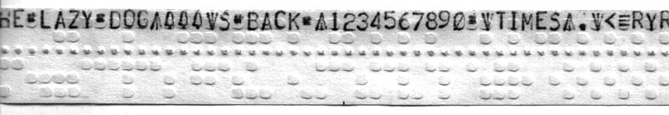
Binary Instructions for CPU
The instructions for CPU to run are binary.
10110000 01100001
Programming on punched tapes
https://en.wikipedia.org/wiki/Punched_tape

Slide 13
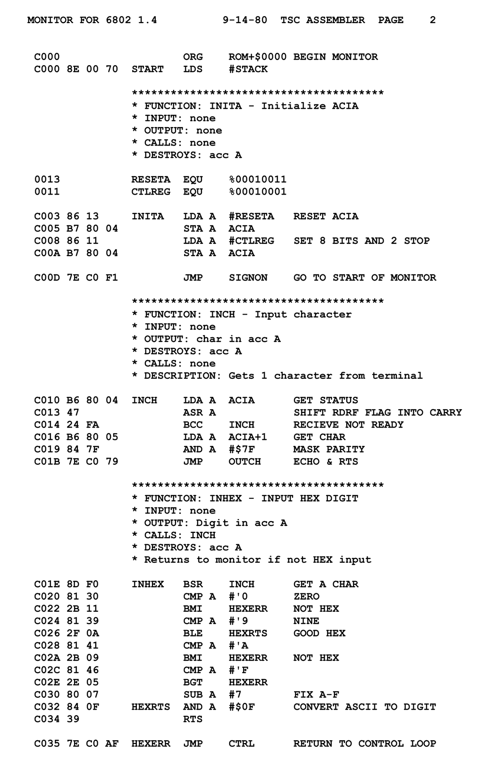
Assembly languages
Assembly languages are more human readable
10110000 01100001
MOV AL, 61h ; Load AL with 97 decimal (61 hex)
https://en.wikipedia.org/wiki/Assembly_language

Slide 14
High Level Languages
C: 1973
Developed by Dennis Ritchie and Ken Thompson at Bell Labs between 1969 and 1973.
C++: 1979
Created by Bjarne Stroustrup as an extension of the C programming language
C with Classes
Renamed to C++
Now it’s C++++++++++

Slide 15


Higher Level Languages
Java: 1995
I hate memory management in C/C++!
I want "Write once, run anywhere”, not ”write once, compile anywhere”.
Grammar is similar with C++.
A Java compiler generates *.class files, not executable files.
Python: 1990
I hate strict grammar!
I hate too many data types!

Slide 16

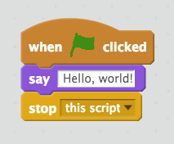
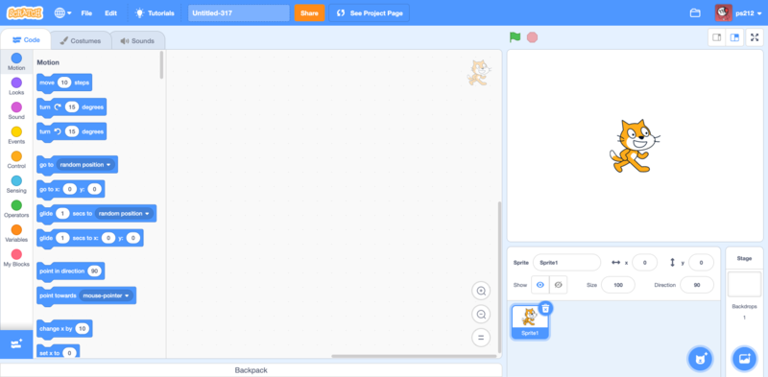
Even higher
Scratch: 2002
I don’t like to type a keyboard

Slide 17





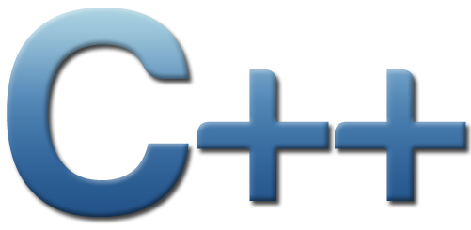
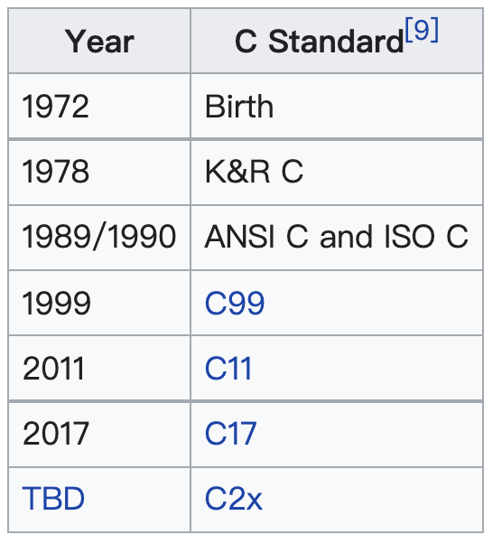
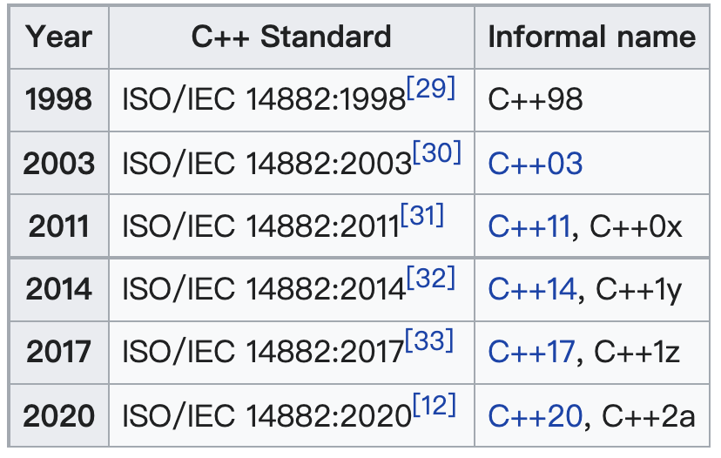
But...
and pointer ..
The grammar is complex,

Slide 18
Advantages of C/C++
Development language of most fundamental computer systems
Linux
MySQL
OpenCV
Backend of TensorFlow, PyTorch
...
High efficiency
Widely optimized compilers
Access memory directly
Excellent on computing
Important language for AI algorithm implementation

Slide 19
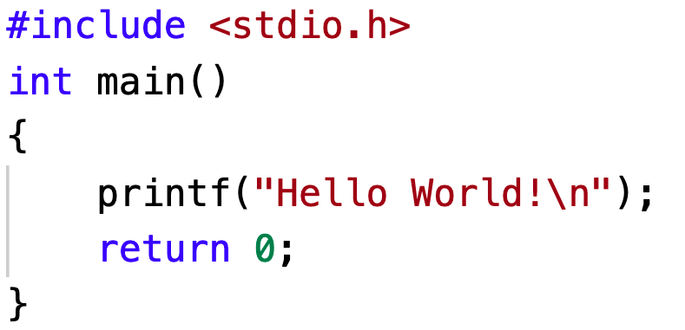
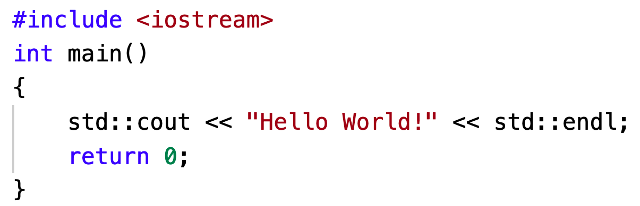
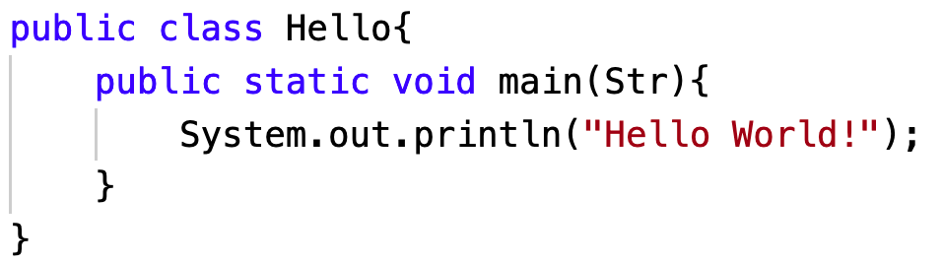
Similar languages
C, C++ and Java

Slide 20
Compile and Link

Slide 21
Two functions
#include <iostream>
using namespace std;
int mul(int a, int b)
{
return a * b;
}
int main()
{
int a, b;
int result;
cout << "Pick two integers:";
cin >> a;
cin >> b;
result = mul(a, b);
cout << "The result is " << result << endl;
return 0;
}
main(): called by startup code
mul() is called in main()

Slide 22
Function prototypes and definitions
function prototypes normally are put into head files (*.h; *.hpp)
int mul(int a, int b);
function definitions normally are in source files (*.c; *.cpp)
int mul(int a, int b) {
return a * b;
}

Slide 23
Separate the source code into multiple files
main.cpp
mul.hpp
#include <iostream>
#include "mul.hpp"
using namespace std;
int main()
{
int a, b;
int result;
cout << "Pick two integers:";
cin >> a;
cin >> b;
result = mul(a, b);
cout << "The result is " << result << endl;
return 0;
}
#pragma once
int mul(int a, int b);
mul.cpp
#include "mul.hpp" int mul(int a, int b)
{
return a * b;
}

Slide 24
Compile and link
Compile
Link
Source file
main.cpp
g++ -c main.cpp
Object file
main.o
g++ main.o mul.o -o mul
Executable file
mul
Source file
mul.cpp
g++ -c mul.cpp
Object file
mul.o

Slide 25
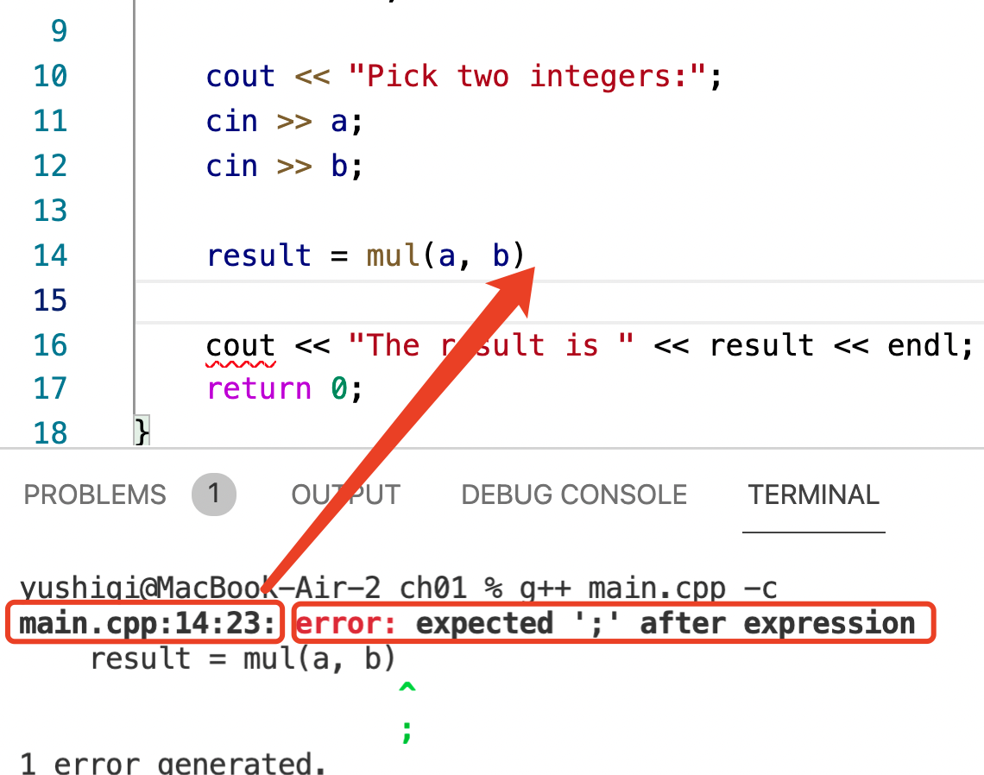
Compilation errors
Normally caused by grammar error
Please check the source code!

Slide 26
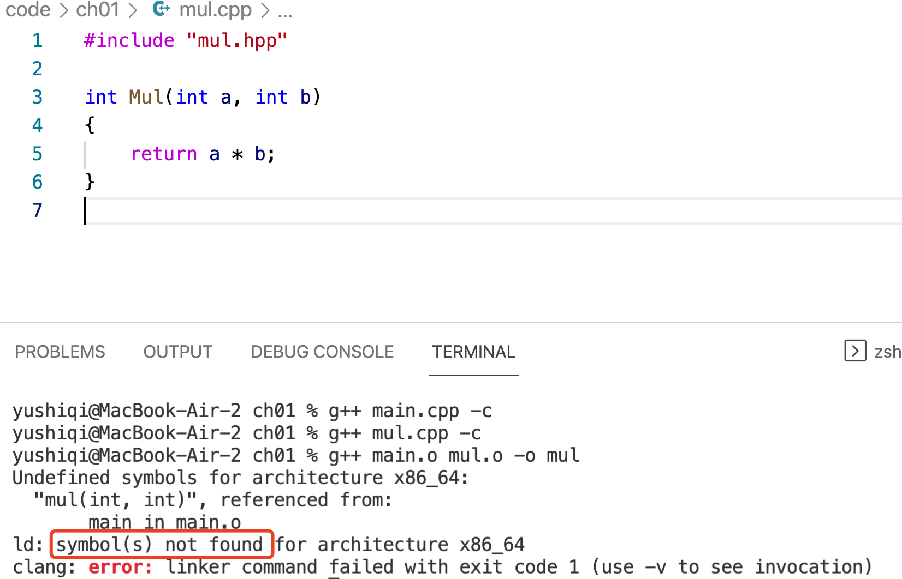
Link errors
"Symbol not found”
Function mul() is misspelled to Mul()

Slide 27
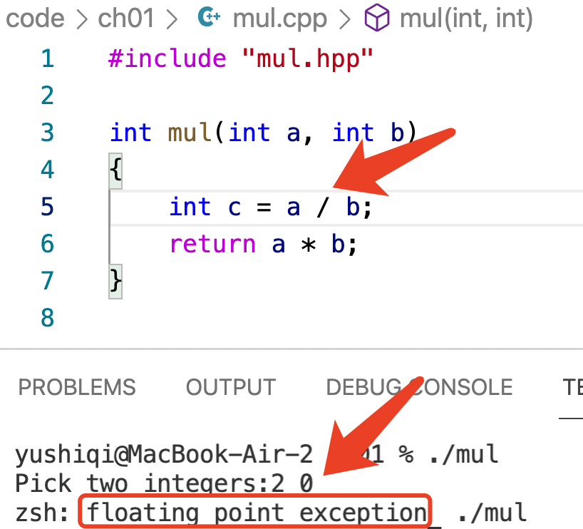
Runtime errors
The source code can be successfully compiled and linked.
The floating point exception (divided by 0) will kill the program.
It is a typical runtime error.

Slide 28
Preprocessor and Macros

Slide 29
Preprocessor
#include <iostream>
#define PI 3.1415926535
#if defined(_OPENMP)
#include <omp.h>
#endif
The preprocessor is executed before the compilation.
Preprocessing directives begin with a # character
Each directive occupies one line
preprocessing instruction (define, undef, include, if, ifdef, ifndef, else, elif, endif, line, error, pragma)

Slide 30
include directive
Preprocess
Compile
main.cpp
#include "mul.hpp"
int main()
{
//
}
int mul(int a, int b);
int main()
{
//
}
main.o
Binary object file

Slide 31
Macros
Preprocess
Compile
circle.cpp
#define PI 3.14
double len(double r)
{
return 2.0 * PI * r;
}
double len(double r)
{
return 2.0 * 3.14 * r;
}
circle.o
Binary object file

Slide 32
Simple Output and Input

Slide 33
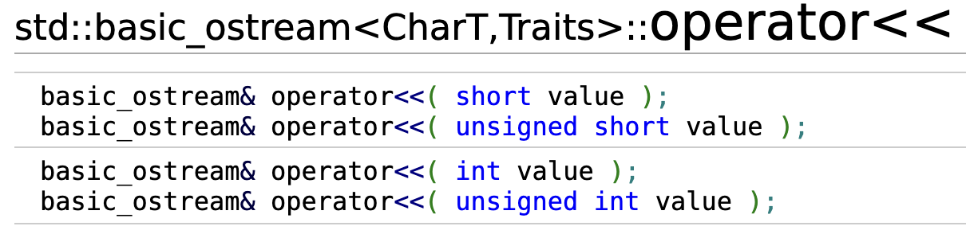
C++ Style Output
What is cout?
std::ostream cout;
cout is an object of data type ostream in namespace std.
cout << "hello." << endl;
<< is an operator which is defined as follows
endl, an output-only I/O manipulator. It will output a new line character and flushes.

Slide 34
C++ Style Input
int a;
float b;
cin >> a;
cin >> b;
Similarly, cin is an object of type std::istream.
>> is an operator

Slide 35
C Style Output
int v = 100;
printf("Hello, value = %d\n", v);
int printf( const char *format, ... ); is a function
format: a string specifying how to interpret the data
%d will let the function interpret v as an integer

Slide 36
C Style Input
int v;
int ret = scanf("%d", &v);
scanf reads data from stdin, and interpret the input as an integer and store it into v;

Slide 37
Why the examples have no GUI?
The programs I used all have GUI. Why the examples have no GUI?
GUI (graphical user interface) is not mandatory.
GUI is for human beings to interact with computers.
No all programs interact with human beings.
We can also interact with the program in a command line window.
We can call a GUI library to create a graphic window by many programming languages. Surely C/C++ can create a GUI window.

Slide 38
Command line arguments
Do you still remember?
g++ hello.cpp -o hello
g++ is an executable program/file
There are three command line arguments
int main() { /* ... */ }
int main(int argc, char *argv[]) {... }
int main(int argc, char **argv) {... }

Slide 39
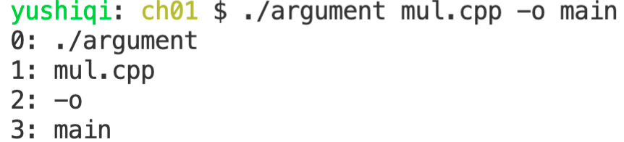
Command line arguments
argument.cpp
#include <iostream>
using namespace std;
int main(int argc, char * argv[])
{
for (int i = 0; i < argc; i++)
cout << i << ": " << argv[i] << endl;
}

Slide 40

But
I don’t like to compile a program in a command window
IDE: Integrated development environment
Microsoft Visual Studio
Apple Xcode
Eclipes
Clion
...
Visual Studio Code (VSCode) is an integrated development environment made by Microsoft for Windows, Linux and macOS

